Slide 1
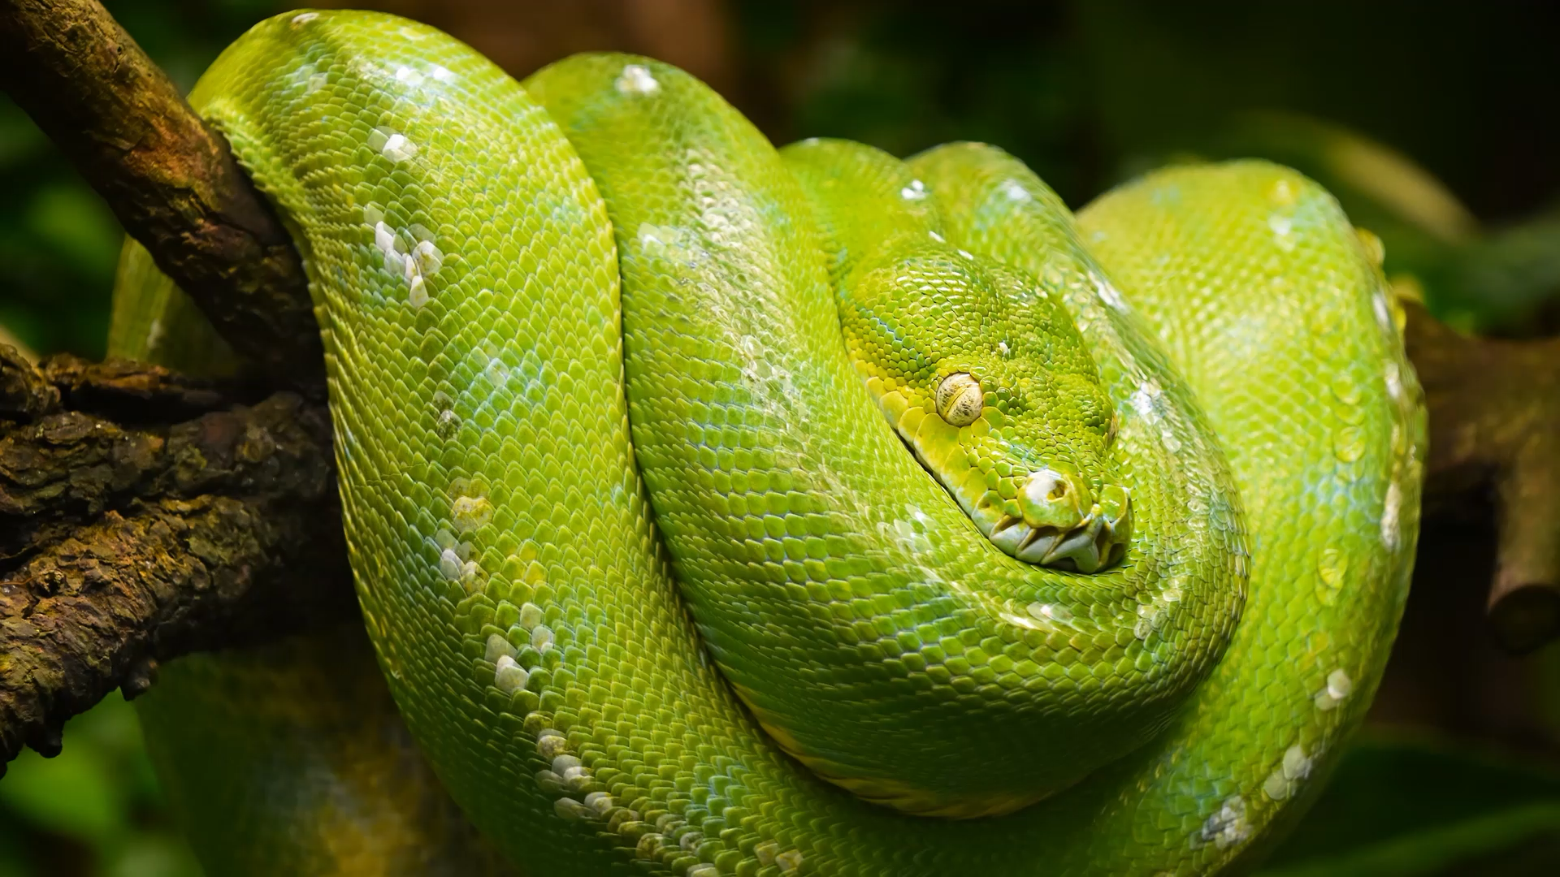
Introduction to Python
Yifeng Peng

Slide 2
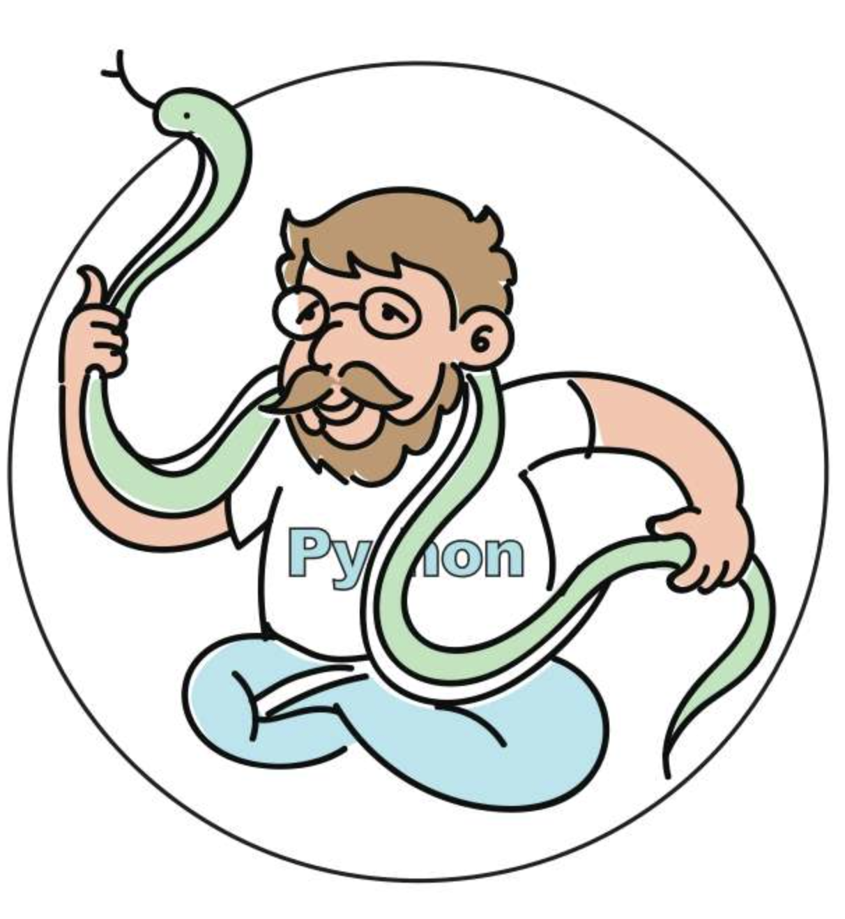
What is Python
A high-level, interpreted, general-purpose programming language
Dynamically-typed and garbage-collected
Support multiple programming paradigms, including structured, object-oriented and functional programming.
Developed by Guido van Rossum
Python 2.0 was released in 2000 and Python 3.0 was released in 2008 (not compatible with 2.0)

Slide 3
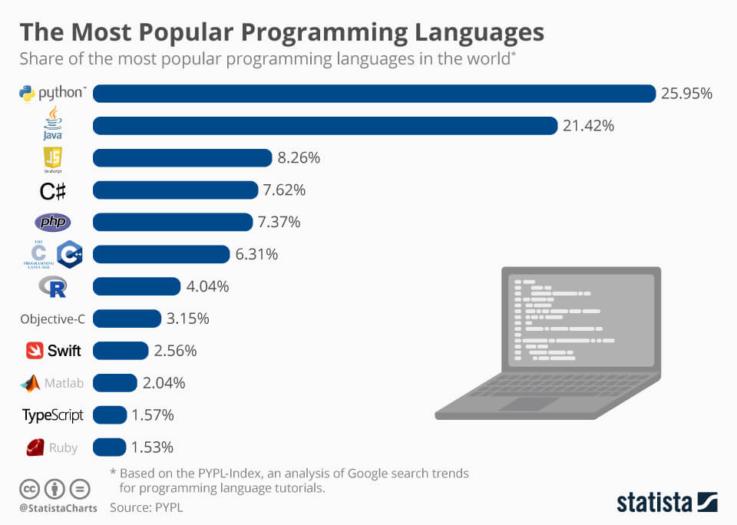
Why python
Easy to learn, open source, free
Easy to Read
Improved productivity
Interpreted language
Dynamically Typed
Vast Libraries Support
Portability
Notes:
3. Python is a very productive language. Due to the simplicity of Python, developers can focus on solving the problem. They don’t need to spend too much time in understanding the syntax or behavior of the programming language.
4. Python is an interpreted language which means that Python directly executes the code line by line. In case of any error, it stops further execution and reports back the error which has occurred
5. Python doesn’t know the type of variable until we run the code. It automatically assigns the data type during execution
6. The standard library of Python is huge, you can find almost all the functions needed for your task. So, you don’t have to depend on external libraries.
But even if you do, a Python package manager (pip) makes things easier to import other great packages from the Python package index (PyPi). It consists of over 200,000 packages.
7. Portaility: In many languages like C/C++, you need to change your code to run the program on different platforms. That is not the same with Python. You only write once and run it anywhere.

Slide 4
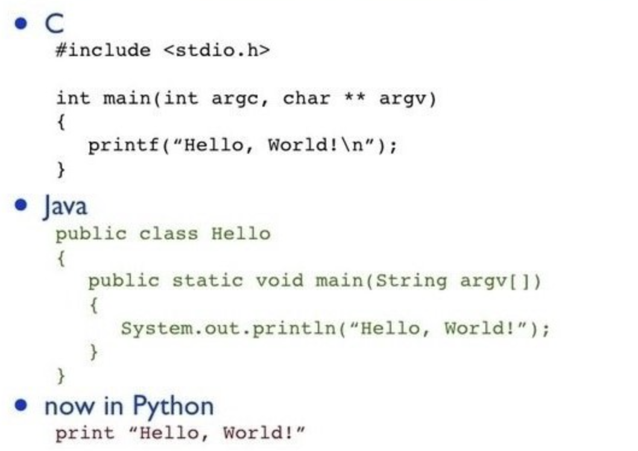
Hello world

Slide 5
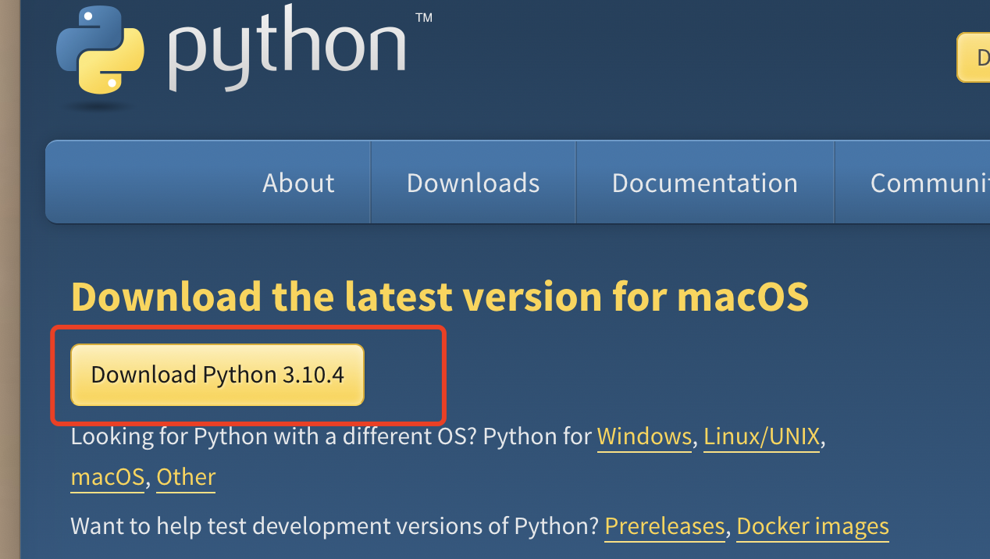
Download Python
Step 1: Google “python”
Step 2: Go to https://www.python.org/
Step 3: Click “Downloads”
Step 4: Download the latest version.
Step 5: Install

Slide 6
Python Programming/Interactive mode
Python has two basic modes: script and interactive.
The normal mode is the mode where the scripted and finished .py files are run in the Python interpreter.
Interactive mode is a command line shell which gives immediate feedback for each statement, while running previously fed statements in active memory

Slide 7
Useful tools for coding
Code editors
Visual Studio Code (Recommended)
Vim (Complex but useful)
Sublime (free and simple)
IDEs
PyCharm (Professional, Powerful)
Spyder(light-weighted)
Notebooks (capable of displaying complex equations, graphs, charts, and more)
Jupyter notebook (Run on local computer)
Google Colab (Run on cloud, no configuration requirement)
Notes:
Integrated development environment (IDE): a software application that provides comprehensive facilities to computer programmers for software development.

Slide 8
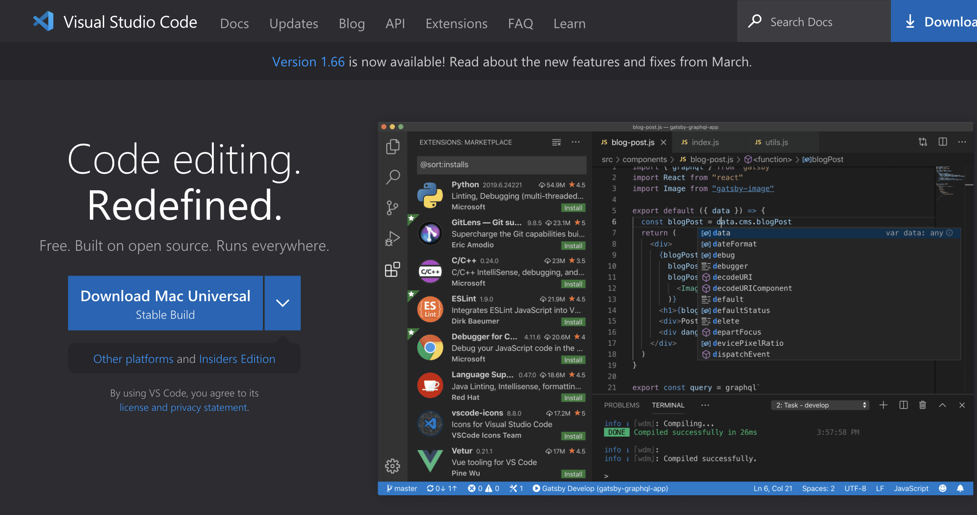
VSCode
With support for hundreds of languages, VS Code helps you be instantly productive with syntax highlighting, bracket-matching, auto-indentation, box-selection, snippets, and more. Intuitive keyboard shortcuts, easy customization and community-contributed keyboard shortcut mappings let you navigate your code with ease.
https://code.visualstudio.com/

Slide 9
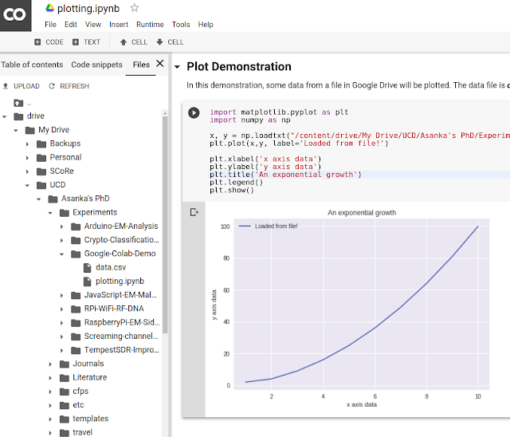
Google Colab
Advantages:
Sharing
Versioning
Code Snippets
Forms for non-technical users
Performance
Price

Slide 10
Python Keywords and Identifiers
Keywords
Reserved words in Python
We cannot use a keyword as a variable name, function name or any other identifier
Define the syntax and structure of the Python language
Case sensitive
Identifiers
Defined by user
Names given to entities like class, functions, variables, etc.
Helps to differentiate one entity from another

Slide 11
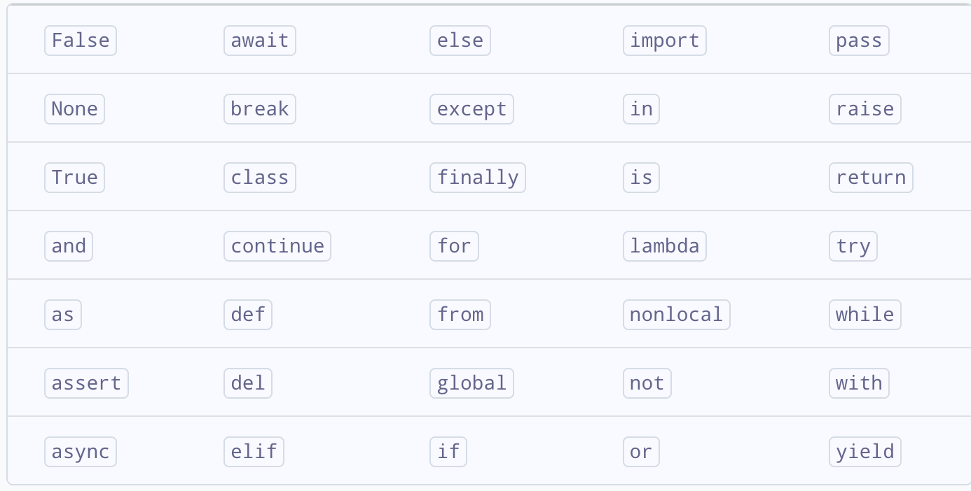
Python Keywords and Identifiers
All keywords in Python 3.10

Slide 12
Python Keywords and Identifiers
Identifier rules
Identifiers can be a combination of letters in lowercase (a to z) or uppercase (A to Z) or digits (0 to 9) or an underscore _. Names like myClass, var_1 and print_this_to_screen, all are valid example. However, the first character cannot be digit. E.g. ”123abc” is invalid.
Keywords and cannot be used as identifiers
We cannot use special symbols like !@#$ etc. in our identifier.
No length restriction
Chinese characters can also be used, but not recommended.
No space

Slide 13
Practice
Which of the following are valid identifiers?
2mail
room 1
User_Name
_sys_val
#Name
None
Class
Hello_world_12345
你的身高

Slide 14
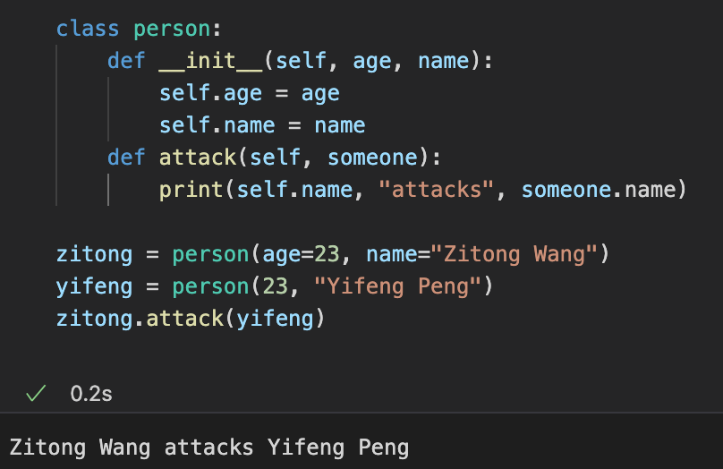
Variable vs Class vs Object vs Function
Constructor (Function), required for every class, used for initialization
Define a class called “Person”
Function, what a person can do
Instantiate a person with attributes.
“classname(attributes)” will automatically call the constructor function of that class
Object

Slide 15
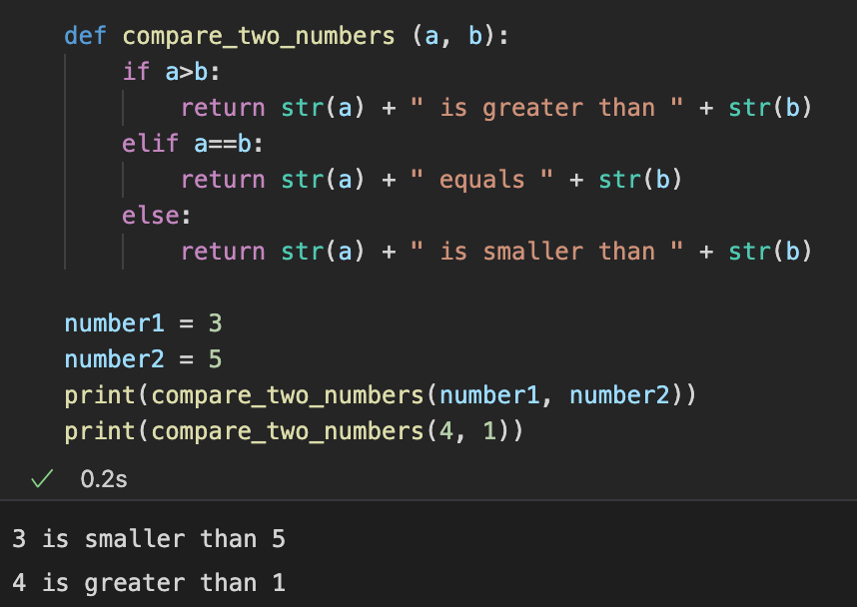
Function
identifier
Define name of Parameters
(cannot be accessed outside the function)
Identifier, define name of the function
Adding two strings means concatenate them
Keyword
Python Built-in function. Convert a variable to a string type
“==” means comparison,
“=“ means assignment
Identifier. We define a variable called “number1”, and assign a value of 3 to it.
Calling the function and enter the required parameters
Built-in function. Output a string to stdout.

Slide 16
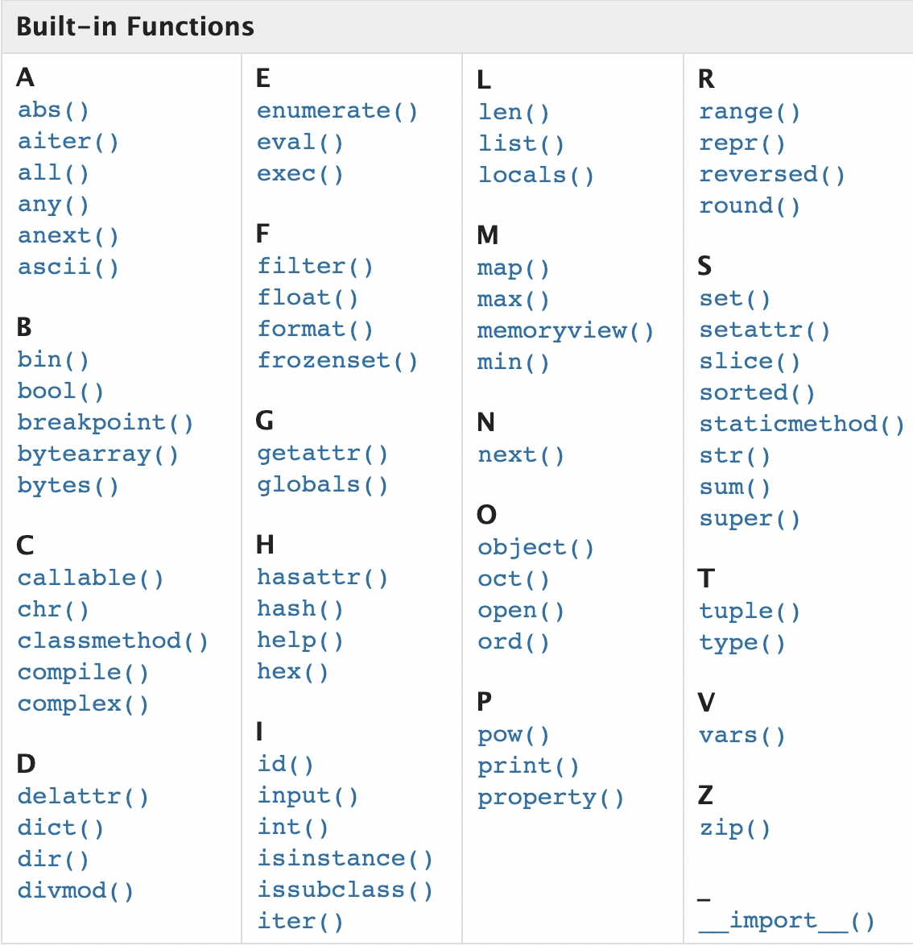
Built-in Functions
abs(x): return the absolute value of x
float(x): return a floating point number constructed from a number or string x
format(x): convert a value to a formatted representation
len(x): return the length of an object. The argument may be a sequence, string, or a collection.
min(args), max(args): return the largest or smallest item in an iterable or the smallest of two more arguments
print: print objects to the text stream file
More info: https://docs.python.org/3/library/functions.html

Slide 17
Syntax
Indentation: refers to the spaces at the beginning of a code line. Where in other programming languages the indentation in code is for readability only, the indentation in Python is very important.
Python uses indentation to indicate a block of code
The indentation can be tabs or spaces of arbitrary length, but it must be there.

Slide 18
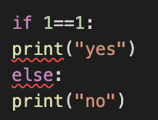
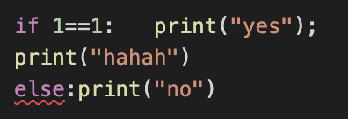
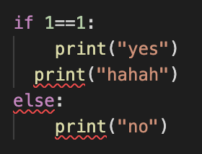
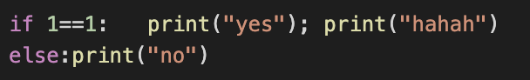
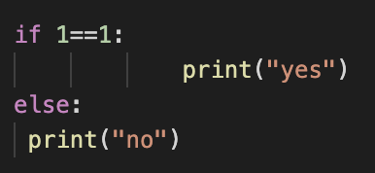
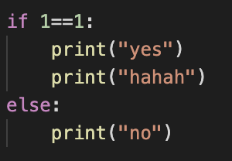
Syntax
invalid
invalid
invalid
valid
Recommended
Consistent indentation length
Using one tab, 2 spaces or 4 spaces is preferred.
valid

Slide 19
Syntax
Python uses four spaces as default indentation spaces. However, the number of spaces can be anything; it is up to the user. But a minimum of one space is needed to indent a statement.
The first line of python code cannot have an indentation.
Indentation is mandatory in python to define the blocks of statements.
The number of spaces must be uniform in any block of code.
Either use whitespace or tabs to indent; intermixing of tabs and whitespaces in indentation may sometimes cause wrong indentation errors. (since some editor will treat one tab as two spaces and some will treat it as four spaces)

Slide 20
Module
A module is a file containing Python definitions and statements. The file name is the module name with the suffix .py appended
Within a module, the module’s name (as a string) is available as the value of the global variable __name__.

Slide 21
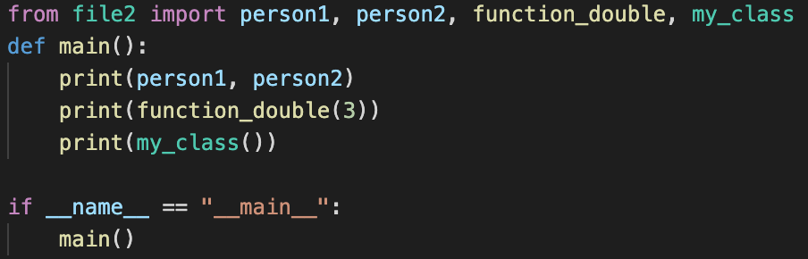
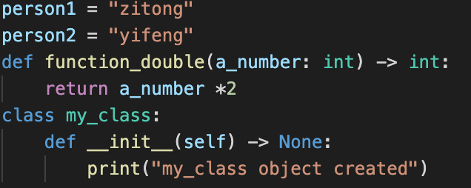
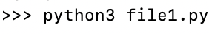
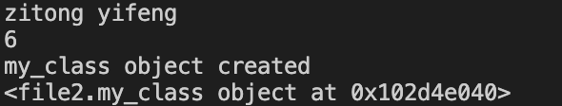
Module
file1.py
file2.py
In command line, execute file1.py
In file2, we define two variables (person1 and person2), a function and a class
In file1, we can import those statements from file2, and use them directly.
output

Slide 22
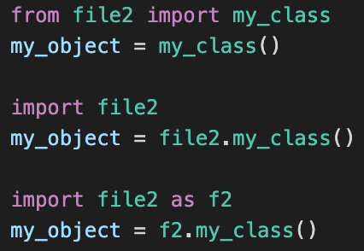
Import
Three ways to import module, they are equivalent
from <module> import <element>
Only import the my_class statement from file2
Import <module>
Import everything from file2, and treat the file as an object
Import <module> as <alias>
Using a user-defined name refer to the module

Slide 23
Practice
Create three separate files, “words.py”, “printer.py” and “main.py”
In words.py, define two variables: a number you like, and one of your favorite quotes.
In printer.py, define a class called ”printer” that has two attributes “number” and “quotes”. The class has one method “print_quote” that requires no additional parameters (except “self”), which can print out the number and quote in one line (hint: using self to access its attributes).
“main.py” only contains a main function and an if statement. In the main function, create an object called “my_printer1” of class “printer” using the number and quotes from words.py and printer.py.
Execute “main.py” should output “the number is <number you choose>, and my favorite quote is <quote>”
Note: words.py and printer.py should have no “import”. Do not re-define the quote and number, and there should be no ”print” in “main.py”

